Slide 1
Introduction to algorithms
University of Technology and Engineering
Vietnam National University Hanoi

Slide 2
Algorithms?
What is an algorithm?
An algorithm is a step by step procedure to solve a problem. An algorithm can be described by nature languages or programming languages.
Example: How to cook rice?
Step 1: Get rice
Step 2: Rinse the rice
Step 3: Put the rice and water into a rice cooker
Step 4: Turn on the rice cooker
Step 5: Check the rice when the rice cooker turns off

Slide 3
Algorithms?
What is a good algorithm?
Correctness
Efficiency
Simple/understandable
Implementable

Slide 4

Algorithms

Slide 5
How to design algorithm?
Step 1: Define the problem clearly
Step 2: Analyze the problem from different perspectives and constrains.
Step 3: Use popular techniques and strategies:
Basic algorithms
Brute force algorithms
Greedy algorithms
Divide and conquer
Dynamic programming
Graph theories
String/text processing algorithms
Step 4: Use flow chart to represent algorithms

Slide 6
Searching problem
Problem: Given a list A consisting of n items. Check if an item X exists on list A?
Simple search algorithm: Iterate from the begin to the end of A to check if X equals to any item of A.
Complexity: O(n)

Slide 7
Sorting problem
Problem: Given a list A consisting of n items. Sort items of list A increasingly?
Example:
A = (1, 2, 5, 3, 8, 9, 2)
Sorting result:
A = (1, 2, 2, 3, 5, 8, 9)

Slide 8
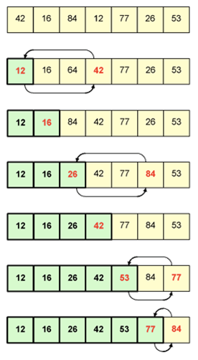
Selection sort
Algorithm
The list is divided into two parts: sorted part and unsorted part.
Repeatedly finding the minimum element from unsorted part and moving it to the end of the sorted part.

Slide 9
Selection sort
Algorithm selection_sort (A, n):
for iter from 0 to n - 2 do
min_idx = iter;
for idx from (iter + 1) to n - 1 do
if A[idx] < A[min_idx] then
min_idx = idx;
swap (a[iter], a[min_idx]);
Complexity:

Slide 10
Searching on sorted list
Problem: Given a list A consisting of n items sorted increasingly. Check if an item X exists on list A?
Binary search algorithm (A):
If A is empty, return False
Compare X with the item Y at the middle of A.
If X = Y, return True.
If X < Y, Perform binary search on the left half of A
If X > Y, Perform binary search on the right half of A
Complexity:

Slide 11
Example
0
1
3
4
5
7
8
9
11
14
16
18
19
l
m
r
0
1
3
4
5
7
8
9
11
14
16
18
19
l
m
r
0
1
3
4
5
7
8
9
11
14
16
18
19
l
m
r
0
1
3
4
5
7
8
9
11
14
16
18
19
l=m =r

Slide 12
Brute Force Search
Systematically evaluate all possible solutions for the problem to determine objective solutions.
Example:
Find all prime numbers smaller than 100
Find all binary numbers of length n
Travel sale man problem

Slide 13
The largest row
Problem: Given a matrix A of m rows and n columns
containing integer numbers. Your task is to find the
row with the largest sum.
Method Find_largest_row (A, m, n):
Complexity:

Slide 14
The largest rectangle
Problem: Given a matrix of A of m rows and n
columns containing integer numbers. Your task is to
find the rectangle in the matrix with the largest sum.
Method Find_largest_rectangle (A, m, n):
Complexity:

Slide 15
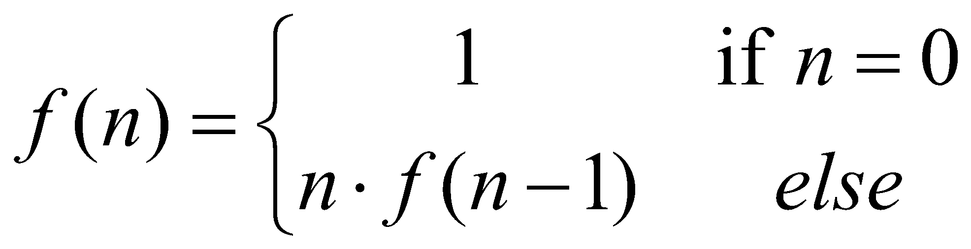
Recursion
Recursion: when a method calls itself
Classic example (the factorial function):
n! = n * (n-1)!
Recursive definition:
Algorithm RecursiveFactorial (int n) {
if (n == 0) return 1; // base case
else return n * RecursiveFactorial (n - 1); // recursive case
}

Slide 16
Content of a Recursive Method
Base case(s).
The cases for which we perform no recursive calls
Every possible chain of recursive calls must eventually reach a base case.
Recursive calls.
Calls to the current method.
Each recursive call should be defined so that it makes progress towards a base case.

Slide 17
Visualizing Recursion
return
4
*
call
6
=
24
final answer
recursiveFactorial
(
4
)
return
3
*
call
2
=
6
recursiveFactorial
(
3
)
return
2
*
call
1
=
2
recursiveFactorial
(
2
)
return
1
*
call
1
=
1
recursiveFactorial
(
1
)
return
call
1
recursiveFactorial
(
0
)

Slide 18
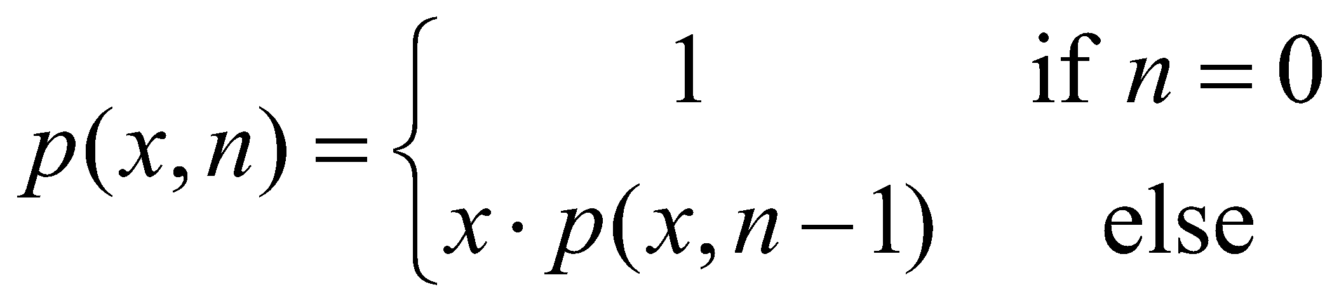
Computing Powers
The power function, p(x, n) = x^{n}, can be defined recursively:
This leads to an power function that runs in O(n) time

Slide 19
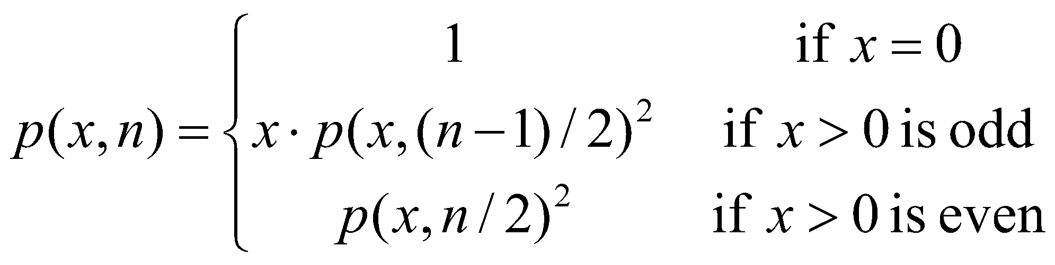
Recursive Squaring
We can derive a more efficient linearly recursive algorithm by using repeated squaring:
For example,
2⁴ = 2^{(4/2)2} = (2^{4/2})² = (2²)² = 4² = 16
2⁵ = 2^{1+(4/2)2} = 2(2^{4/2})² = 2(2²)² = 2(4²) = 32
2⁶ = 2^{(6/ 2)2} = (2^{6/2})² = (2³)² = 8² = 64
2⁷ = 2^{1+(6/2)2} = 2(2^{6/2})² = 2(2³)² = 2(8²) = 128.

Slide 20
A Recursive Squaring Method
Algorithm Power(x, n):
Input: A number x and integer n = 0
Output: The value x^{n}
if n = 0 then
return 1;
if n is odd then
y = Power(x, (n - 1)/ 2);
return x · y ·y;
else
y = Power(x, n/ 2);
return y · y;

Slide 21
Analyzing the Recursive Squaring Method
Algorithm Power(x, n):
Input: A number x and integer n = 0
Output: The value x^{n}
if n = 0 then
return 1;
if n is odd then
y = Power(x, (n - 1)/ 2);
return x · y · y;
else
y = Power(x, n/ 2);
return y · y;
Each time we make a recursive call we halve the value of n; hence, we make log n recursive calls. That is, this method runs in O(log n) time.
It is important that we used a variable twice here rather than calling the method twice.

Slide 22
Find all binary numbers
Problem: Find all binary numbers of length n.
Example: n = 3
000,001,010,011,100,101,110,111
Algorithm binary_number(b, k, n):
for v for 0 to 1 do
b[k] = v;
if (k==n) then
print b;
else
binary number (b, k + 1, n);
Complexity:

Slide 23
Find permutations
Problem: Find all permutations of length n.
Example: n = 3
123, 132, 213, 231, 312, 321
Algorithm: Find_permutations (n):
Complexity:

